Slide 1

Vaf had a van. The van was fast.

Slide 2
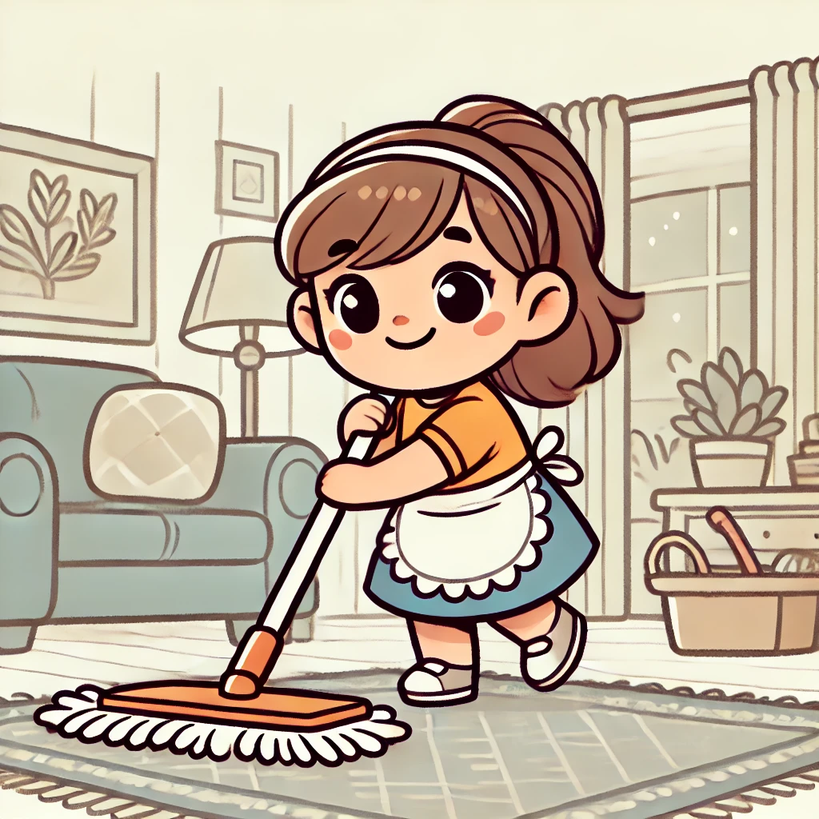
Mof had a mop.
She cleaned the rug.

Slide 3

Suf had a sun hat.
It was big!

Slide 4

Wif saw a wig. It was pink.

Slide 5

Fef had a fig.
It was sweet!

